Slide 1

City Express based on Blockchain
( Design )
Rookie Miners
XU Rui (56365524)
HONG Yuan (56373801)
WANG Yuchun (56532945)
HON Yuen Ching (56255901)
LU Jie (56509782)

Slide 2

TABLE OF CONTENTS
Introduction
01
02
Design of Blockchain Application
03
Deployment of Blockchain Application
04
Future Work and Possible Extensions
Potential Challenges and Impact
05

Slide 3

01 Introduction
Overview
Industry Pain Point
Blockchain Framework

Slide 4


Overview
Rookie City Express (RCE)
A peer-to-peer intra-city delivery platform
Provide a decentralized, trustless, reliable online express system for sending and receiving packages
Marked features of RCE like automatic billing and confidential signing will be realized via smart contract
Notes:
Provides the automated audit trail of the orders
Update the state of the transaction in time
Orders update only when transactions are approved by the appropriate participants (Smart Contract Rule)
The transaction is immutable and irreversible
Apply hash and the signature to guarantee the safety of transaction
Privacy of user is encrypted by the private key

Slide 5
INTRODUCTION
Industry pain points
01
02
03
04
05
Lack of automatic billing system based on weight, delivery distance and time.
Risk of modification of package information and order detail
Risk of losing packages and delivery error
Less protection for users’ information resulting in privacy leakage
Too much trust needed in the process between users and express companies

Slide 6
02 Design of Blockchain Application
Use Case Demonstration
Entity-relation Diagram
Data Flow Diagram
Business Architecture

Slide 7
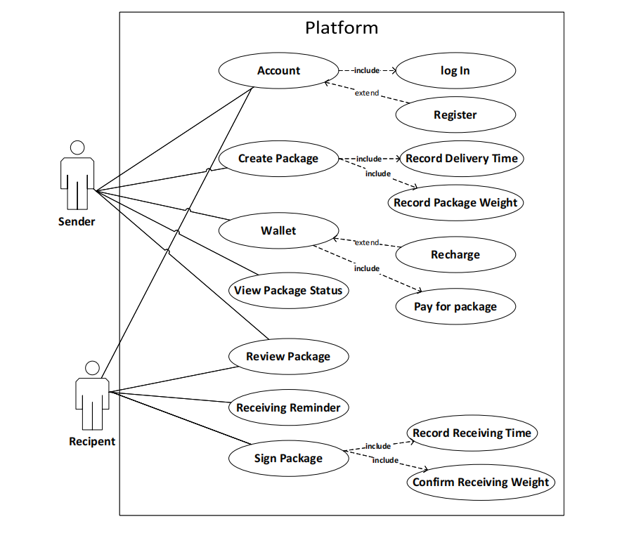
Use Case Demonstration
2 kinds of users:
Sender
Recipient
7 Use cases:
Account
Create Order
Wallect
View Order Status
Review Order
Receiving Reminder
Sign Order

Slide 8
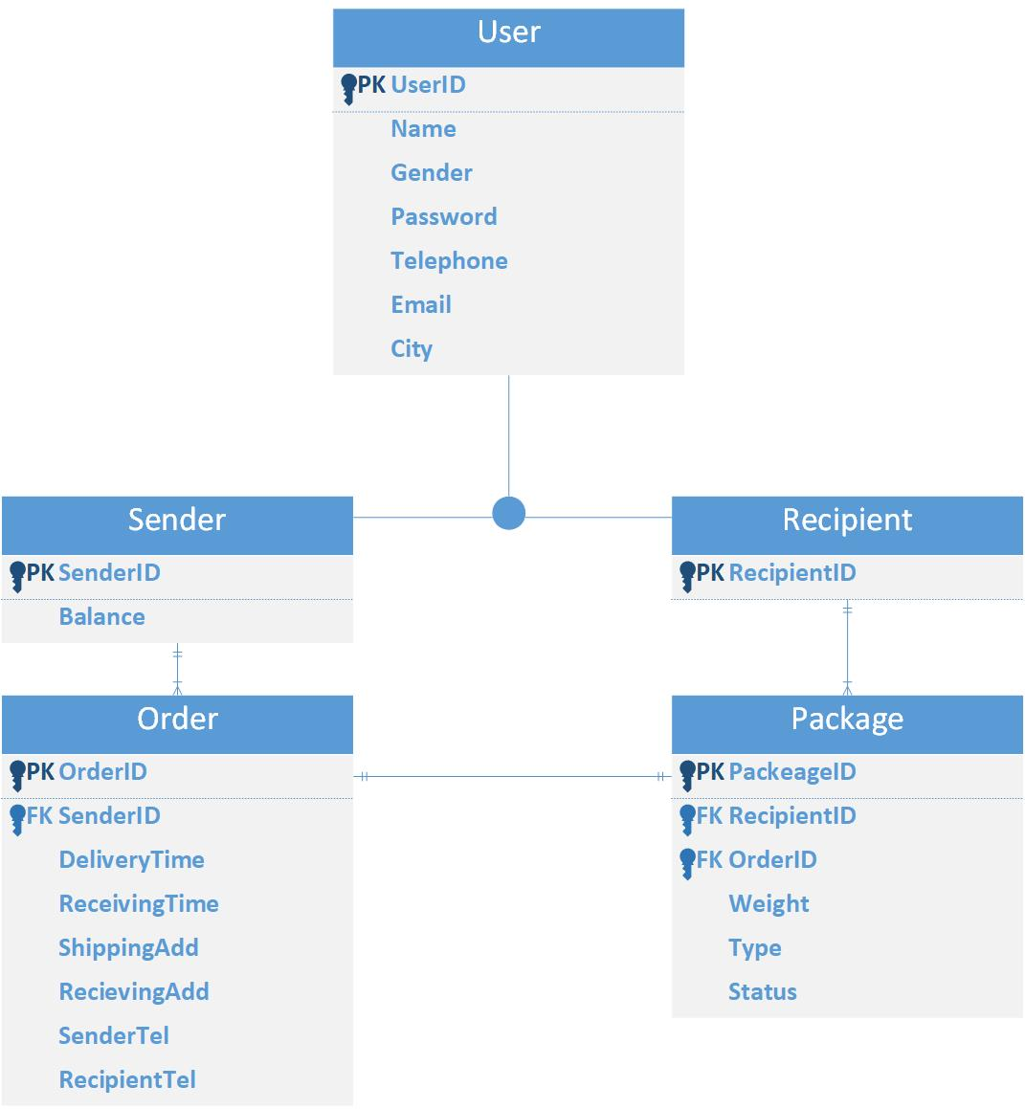
Entity-relation Diagram - Relationship
One to Many relationship
One to One relationship
Sender and order:
One sender can create many orders to deliver the package
One order can only be created by one sender
Recipient and package:
One package can only be sent to one recipient
One recipient can receive many packages.
Order and package:
One order can only contain one package
One package can only belong to one order.

Slide 9
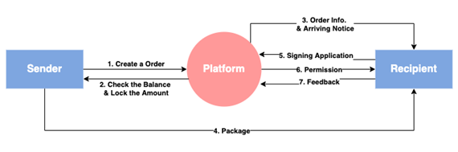
Business Flow
How does it work?
2 participants and 1 platform
The sender buy crypto coins, charges in their wallet and creates the order on the platform
The order information will circulate between the recipients and platform
The records of payment and balance will circulate between the platform and users
Notes:
Once an order is created by a sender, system will check the balance. Then, the recipient will be noticed the package information. And after checking the identification, the recipient will get access to unlock the package. At this moment, the receiving time is also recorded to calculate the shipping fee. Once the package is confirmed, the corresponding amount will be deducted by the formula set in smart contract.

Slide 10
03 Deployment of Blockchain Application
Blockchain Framework
Blockchain Network Diagram
Business Network Deployment
Web Interface and Function Demonstration

Slide 11

Blockchain Framework
Hyperledger Composer
Determine Business network definition & Logic of transaction & Access Control Rules of Blockchains
Define the transactions, participants and assets in the model file
Hyperledger Fabric
An open-source enterprise-grade permissioned distributed ledger technology (DLT) platform, designed for use in enterprise contexts

Slide 12
Network Diagram
O: Order server
Organization R0: Rookie Miners
Organization R1: RCE
Peer Node P1: Management staff of
Application A1: RCE application
Certification authority CA1: Certification authority for R1

Slide 13
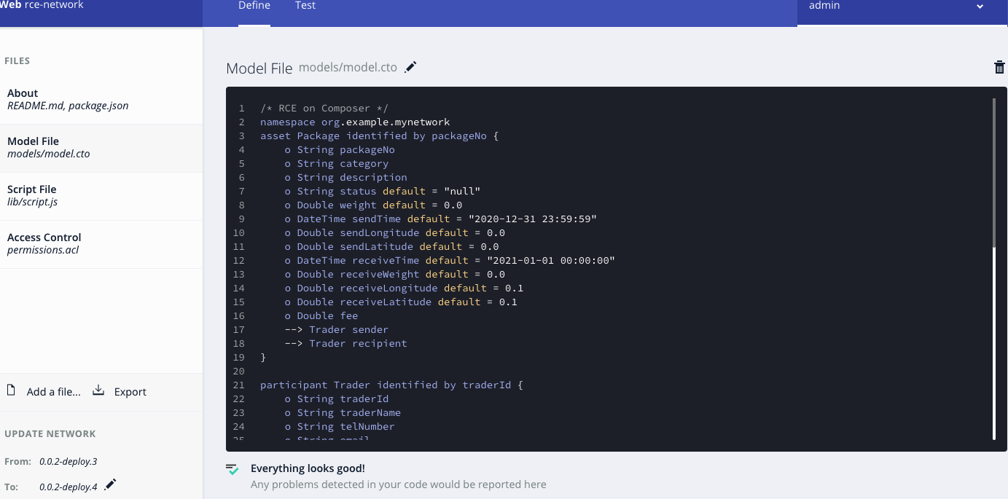
Business Network Deployment
Model Definition (.cto file)
asset Package identified by packageNo
participant Trader identified by traderId
transaction Charge
transaction Send
transaction Receive

Slide 14
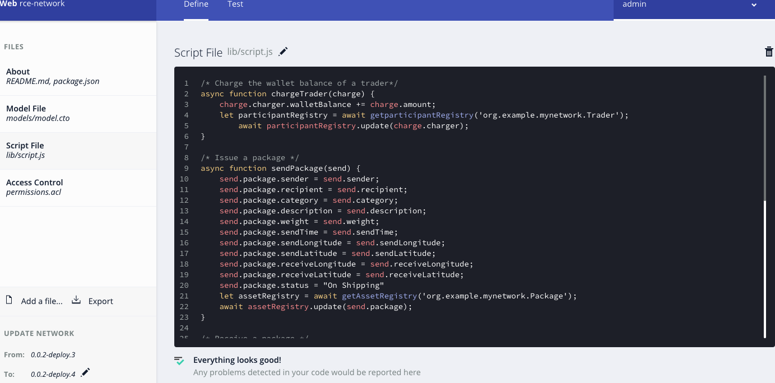
Business Network Deployment
Smart Contract (.js file)
async function chargeTrader(charge)
async function sendPackage(send)
async function receivePackage(receive)

Slide 15
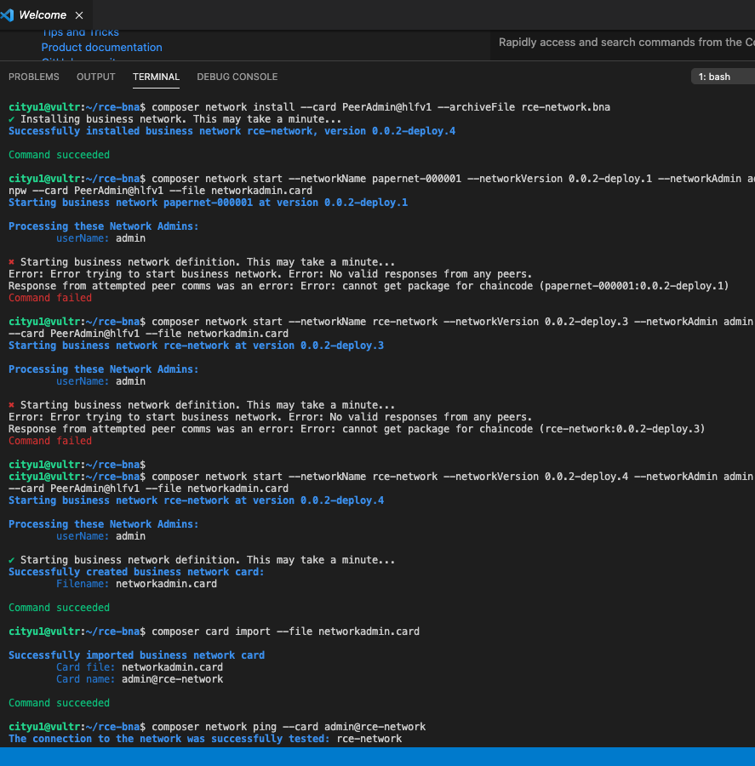
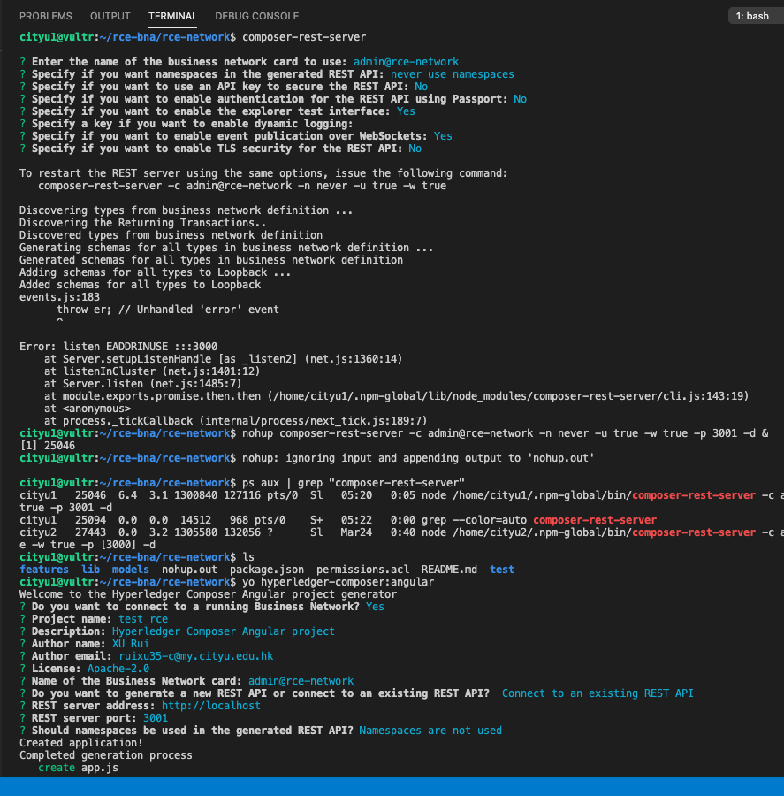
Business Network Deployment
Lunch in SSH
export .bna from Composer Playground
Upload and install .bna on SSH server
Setup REST
Setup Angular

Slide 16
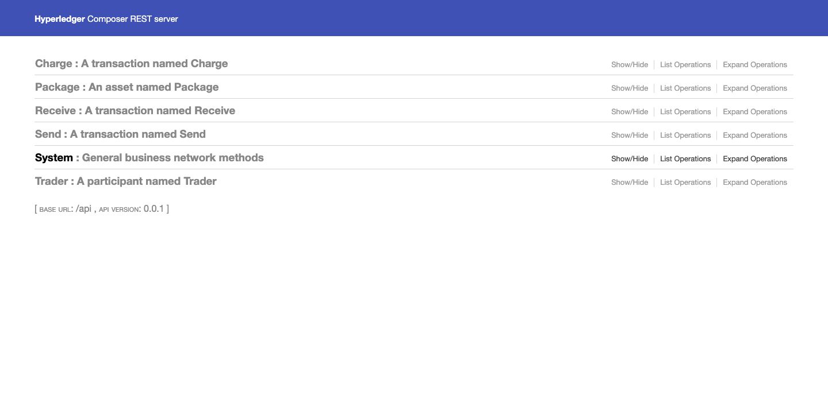
Interface & Demonstration
REST API
A middle stage to record and display any operation and transaction
URL: http://45.76.212.69:3001/

Slide 17
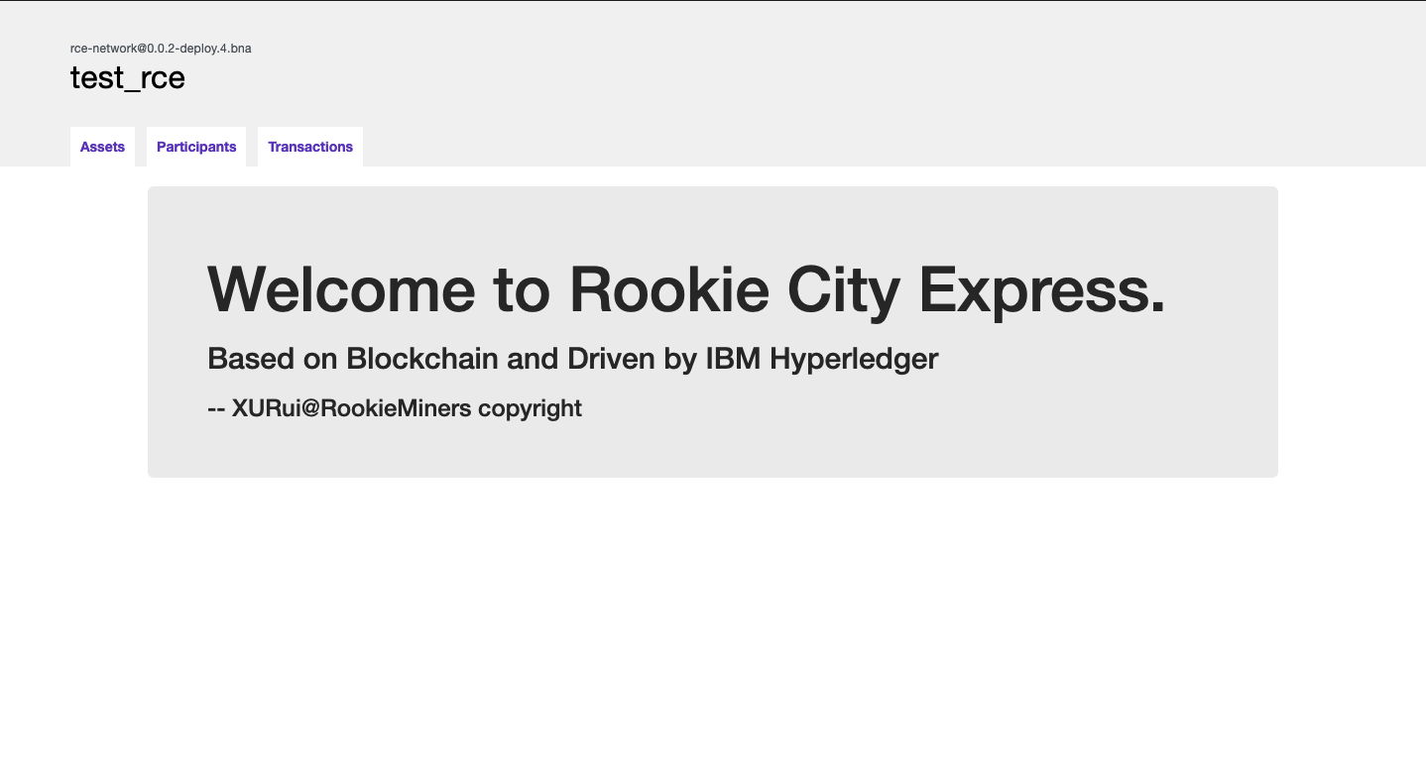
Interface & Demonstration
User Interface (based on Angular)
A website-based user interface to realize application function
URL: http://45.76.212.69:4201/

Slide 18
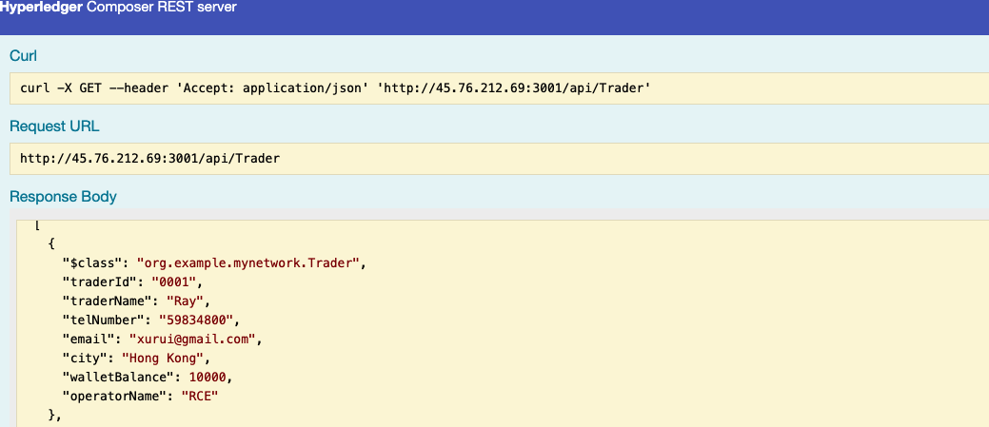
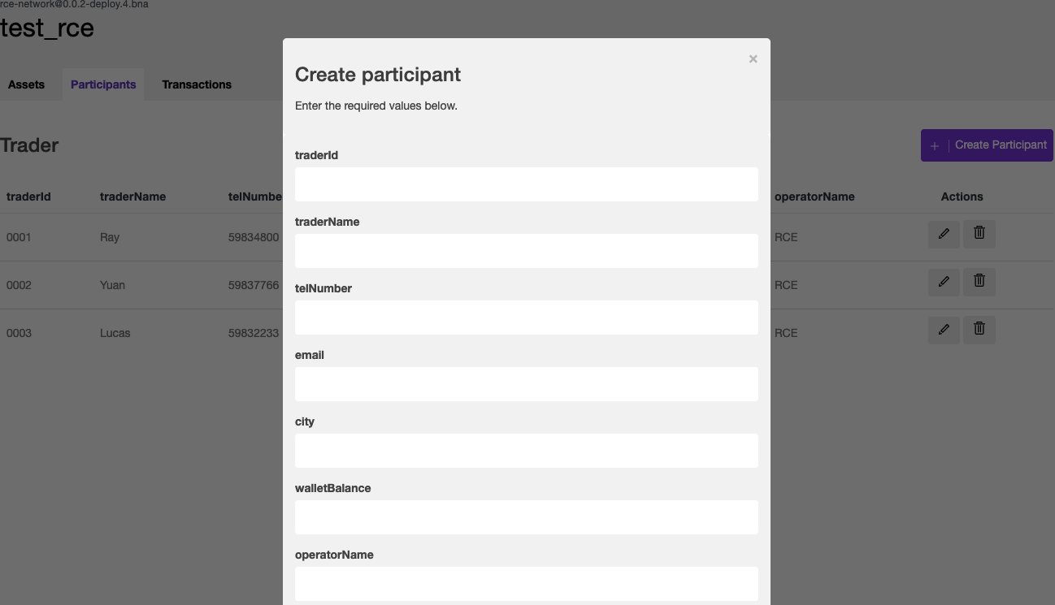
Interface & Demonstration
Demonstration on REST server and RCE website application

Slide 19
04 Future Work and Possible Extensions
Assessment
Future Extension and Plan

Slide 20
Assessment-Advantages of Design
The immutability of data
More customer privacy
Avoid delivery error or loss
Only through the coordination among nodes, a consistent account can be generated. This means that our data is not easy to be changed, making the whole express transportation process more open and transparent.
If a transaction in the block changes, its hash value will also change. This makes the whole process of data security higher, customer privacy protection problem can be solved, to ensure the security of the transaction.
Our database transport billing transaction process is fully automated, and in the user transaction to join the private key encryption, data update, avoid the express delivery error or loss.

Slide 21
Assessment-Drawbacks of Design
Inconvenience
Illegality
Users need to buy crypto coins used in our platform before they use it. This may be some inconveniences in use.
There may be some illegal transportations due to the protection of the privacy.

Slide 22
Future Extension and Plan
Add more functions
Modify our platform
Cooperate with bank
For Recipient
Add a brief information of delivery man
(E.g. Name of the delivery man, Rating of service, Contact No.)
Recipient can directly contact the delivery man if there is any enquiry of a package
Aim for intelligent platform
E.g.
A sender/recipient entered a specific shipping or receiving address frequently
Ask the user set it to default address
The chance that enter a wrong address decreases
Include incorporating banks
Currency
More users can charge their wallet by their default currency in bank
Our application can be universalized in our society

Slide 23
Future Extension and Plan
Promote company-to-company (specific industry) 🌟
Promote advanced express service
Not only JUST 'one-to one' service
E.g. Insurance industry (AIA, Manulife)
Cooperated project
Needed to share some internal data with adequate transparency
We can open the network to both company
All the staffs will be able to access and collect some public data
Apply to fresh ingredient delivery service
Fresh ingredients
Organic ingredient
Ingredient without preservative
Easily to spoiled
Food security problem
Our system record every stop of delivery
Real time journey
Able to trace back if there is any problem happened

Slide 24
5 Potential Challenges and Impact

Slide 25
Potential Impact of the Project
Normalize the Fee of the Delivery
Make the Speed of Delivery Faster
Reduce the Delivering Mistakes
Reduce the Risk of Modification
Promote the Development of Other Industries
RCE
Impact

Slide 26
THANKS
Q&A

